Slide 1
Lessons Learned:
Improving Surgical Antibiotic Prophylaxis Timing
Twisha S. Patel, PharmD, BCPS
Clinical Specialist, Infectious Diseases
Adjunct Clinical Instructor
University of Michigan Health System
University of Michigan College of Pharmacy
ASPIRE – 7/21/2017

Slide 2
Overview
Investigate
the question
Michigan Medicine experience
Identify
areas for improvement

Slide 3
Identifying the Problem
  Historical Practice: 2004-2016 institutional guidelines recommended starting beta-lactam antibiotics between 30-60 minutes and vancomycin between 60-120 minutes.
Several questions raised:
  How much of the antibiotic needs to be infused prior to incision?
  Is 30 minutes prior to incision better or worse than 60 minutes prior to incision?
  If administering as an IV push as opposed to infusion, how does that impact timing?
  Etc…

Slide 4
Overview
Investigate
the question
Michigan Medicine experience
Identify
areas for improvement

Slide 5
Does timing even matter?
Pre-op vs. Post-op
p = 0.01
Cases of Infection
Hours Before and After Incision
Stone HH, et al., Ann Surg 1976;184(4):443-452

Slide 6
Landmark Study - 1992
2016 WHO guidelines call for timing <120 minutes or <60 minutes for antibiotics with short half-lives
2-24 hour
pre-incision
0-2 hours
pre-incision
within 3 hours
post-incision
>3 hours
post-incision
Classen DC, et al., N Engl J Med 1992;326: 281–86.

Slide 7
PK Parameters –
Commonly Used Antimicrobials
Antimicrobial | Time to peak, serum | Time to peak, tissue | Distribution | Protein binding | Elimination | t ½
Cefazolin | 10-20 min | Up to 1 hr | Widely into most body tissues & fluids | 84% | Renal (80-100% unchanged) | 1.8 hrs
Cefuroxime | 20 min | 35 min | Lower in bone & body tissue vs.serum | 50% | Renal (89%) | 1.3 hrs
Vancomycin | 1 hr | Up to 3.5 hr | Lower in fat, sternum & bone vs. tissue/ serum | 55% | Renal | 4-6 hrs (5-13 hrs)
Cefuroxime for Injection [prescribing information]. Schaumburg, IL: Sagent; 2010
Metronidazole for Injection [prescribing information]. Deerfield, IL: Baxter; 2015
Bratzler DW, et al., Am J Health-Syst Pharm 2013;70:195-283
Cefazolin for Injection [prescribing information]. Schaumberg, IL: Sagent; 2013
Vancomycin for Injection [prescribing information]. Lake Forest, IL:Akorn-Strides, LLC; 2009

Slide 8
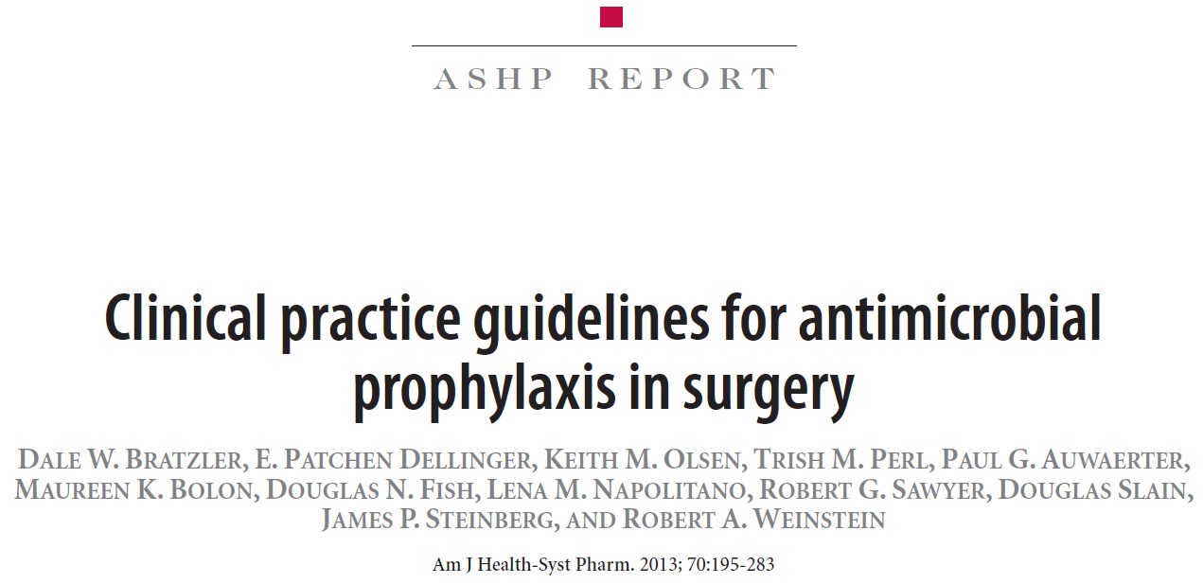
ASHP Surgical Prophylaxis Guidelines
Recommendation
(most antimicrobials):
within 60 minutes of incision
Increasing interest in narrowing the window!
ASHP
American Society of Health-System Pharmacists
IDSA
Infectious Diseases Society of America
SIS
Surgical Infection Society
SHEA
Society of Healthcare Epidemiology of America
Bratzler DW, et al., Am J Health-Syst Pharm 2013;70:195-283

Slide 9
Antibiotic Timing and SSI Rates
Odds ratio of SSI from 32,459 patients undergoing hip or knee arthroplasty, colorectal surgical procedures,
arterial vascular surgical procedures, and hysterectomy
Hawn et al. JAMA Surg. 2013; 148(7): 649-657

Slide 10
Antibiotic Timing and SSI Rates
Percent of Post-operative SSI by Time of Prophylaxis Administration
for 28,250 Patients undergoing Cardiac Surgeries
Koch CG, et al., J Thorac Cardiovasc Surg 2012;144:931-937

Slide 11
Hot Off the Press!
General surgery adult inpatients
Swiss hospitals
Randomized (1:1), controlled trial
  1.5 gm IV of cefuroxime early or late administration
Primary endpoint: SSI within 30 days of surgery
Weber WP, et al., Lancet Infect Dis 2017;17: 605–14

Slide 12
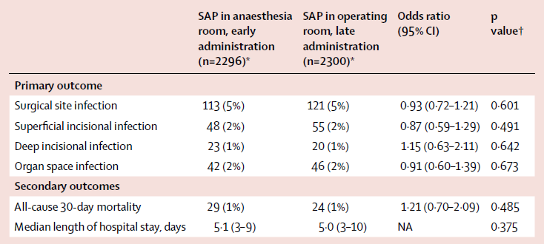
Hot Off the Press!
Median time to administration:
42 min (IQR 30-55)
Early: 2296 patients
4596 patients to evaluate
Median time to administration:
16 min (IQR 10-25)
Late: 2300 patients
Early Late Odds Ratio p value
Weber WP, et al., Lancet Infect Dis 2017;17: 605–14

Slide 13
Overview
Investigate
the question
Michigan Medicine experience
Identify
areas for improvement

Slide 14
New Antibiotic Timing Recommendations as of 2016
Start antibiotic infusion 15-60 min prior to incision for beta-lactams
Start antibiotic infusion 60-120 min prior to incision for levofloxacin, ciprofloxacin, vancomycin, gentamicin > 5mg/kg, azithromycin, fluconazole

Slide 15
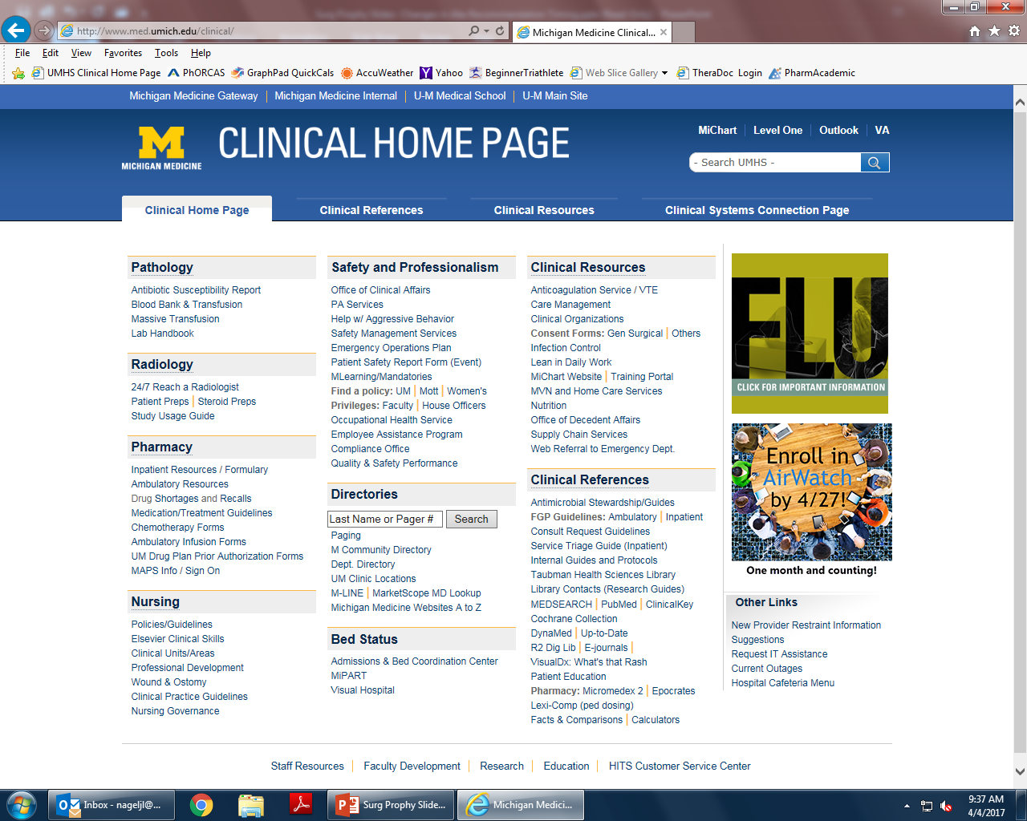
Stewardship Website

Slide 16
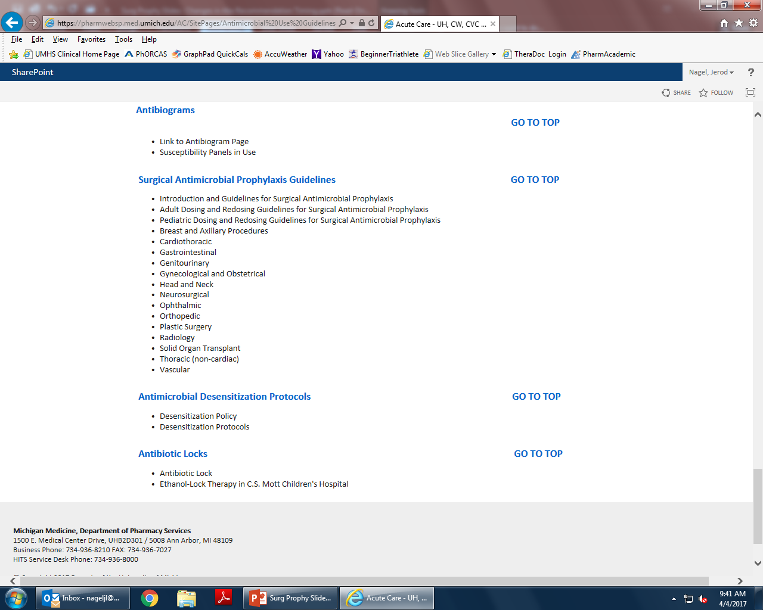
Stewardship Website

Slide 17
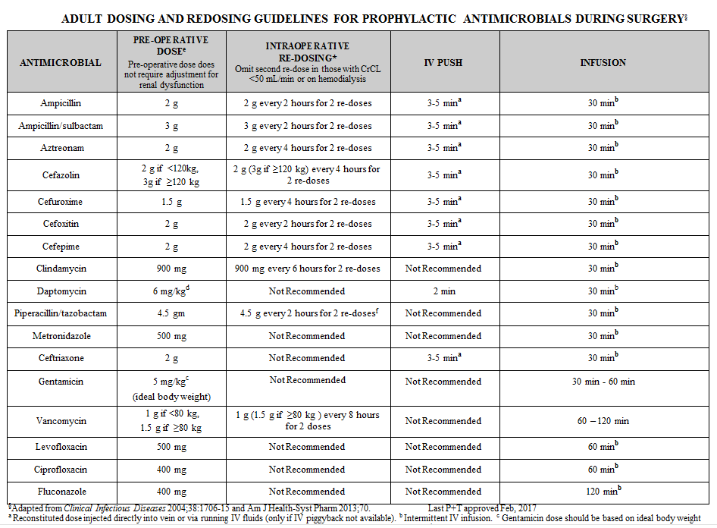
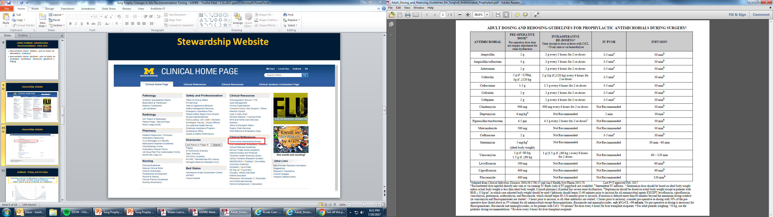

Slide 18
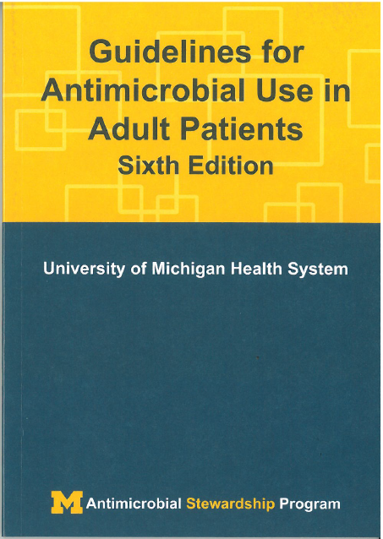
Michigan Medicine “Blue Books”

Slide 19
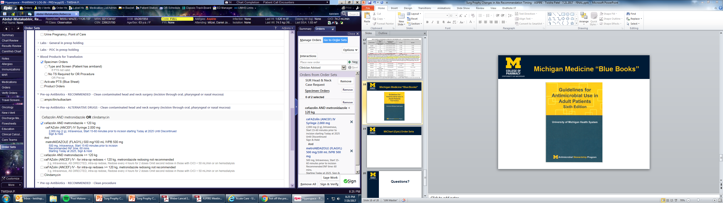
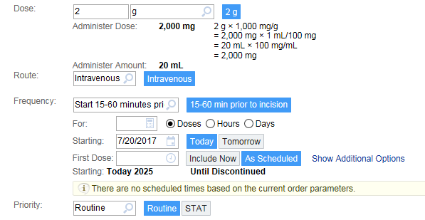
MiChart (Epic) Order Sets

Slide 20
Other Strategies
Education, education, education!
  Live sessions
  Email communications
  Specialized training
Collaboration is key!

Slide 21
Questions?
Twisha S. Patel, PharmD, BCPS
Clinical Specialist, Infectious Diseases
twishap@med.umich.edu

