Slide 1
Process of Quality Improvement—
The Colorado Experience
Leslie Jameson MD
University of Colorado
Department of Anesthesiology
Notes:
----- Meeting Notes (3/12/15 20:32) -----
THANK YOUR HOSPITALITY
PRAGMATIC TALE OF THE CO EXPERIENCE
Choices SELF IMPOSED
EVENTS that led to them –less so
RESPONSE TO A CULTURAL CHANGE
WE OVERALL FEEL IS GOOD—MAYBE GREAT ABOUT IF WE CAN GET IT RIGHT

Slide 2
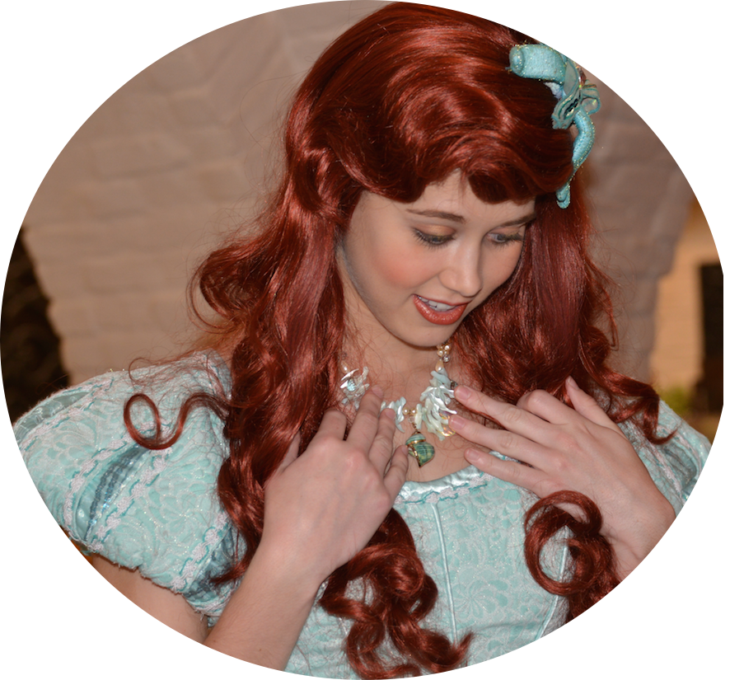
Change!!!! Who?
Me??
You??
Everyone!!!
Notes:
FIRST ITEM OF BUSINESS --what to agree something could be done better OR MORE CONSISTENTLY
CHANGE ACCELERATED BY MANDATED ACTIVITIES—SCIP, TIME OUT
SWIRL OF CULTURAL CHANGE—INCLUDING HAVING MEDICINE COMPARED TO A RESTAURANT FACTORY CHEESECAKE FACTORY.
introduced a new concept—CONSISTENCY
IMPOSED CONSISTENCY—STANDARD PROCESSES
OTHER EVENTS-- “TOO ERR IS HUMAN”
SUCCESS OF VA NSQIP LATER
ATUL GAWANDE—COMPLICATION NOTES ON AN IMPERFECT SURGEON-- 2002

Slide 3
Why?
PUBLIC →Regulators→ Medical Community
Want to create change in medical practice
Result in improved measured outcome
  Patient satisfaction (high hospital ratings)
  Lower morbidity (eg, infection, readmission, LOS)
  Reduced medical costs (no morbidity)
Motivator
  Personal satisfaction (the most effective motivator)
  Money (2015 CMS → QCDR )
  Money (Credentials)
  Money (Highly rated hospital-Patients)
  Money (Licensure, ABA certification)
Notes:
PUBLIC—TIRED OF PAYING FOR US AND NOT GETTING GOOD VALUE
POLITCAL AND ACCURATE
SOME PLACES AN APPY AS $100 AND OTHER $100,000
LOTS OF WHYS
THE CONCEPT ON INCREASING THE LEVEL OF AWARENESS WAS PROBABLY RIGHT
QUANTITATE CULTURE—NEEDED TO MEASURE AND HAVE A CONSEQUENCe
Know cost too much for too little

Slide 4
How?
MEASURE discrete a selected medical process (eg, SCIP, PQRI requirements)
  Assess DOCUMENTED Care that is important
  EDUCATE participants
      Make a group process or an individual one
  MEASURE for Change in Practices
    Maintain gains
  PROVIDE CONTINOUS PERFORMANCE REASSESSMENT– Medicine and public
Notes:
Emphasis on measuring a activity or process
but not so good at measuring a outcome or a consequence
Assure ourselves we continue the porcess—BEST BET CONTINUOUS REASSESSMENT—OF WAHT

Slide 5
Lucian Leap’s Statement on Change
(Author of Too Err is Human IOM Report)
Errors & Failure are caused by system breakdowns not individual carelessness.
Changing systems (clinical actions) is hard work and requires serious commitment, leadership and perseverance.
  Must overcome TRADITION, TRADITION while we MOTIVATE MOTIVATE MOTIVATE!!!
Most powerful method for reducing harm is feed back, learning from the best, and working in collaboration .
ASPIRE
Adapted from JAMA FEB 3 2015; 313(5):467-8)
Notes:
TITLES OF JAMA
FEB 3 ISSUSE PROFOUND EDITORIAL BY DR. LEAPE
BASICALLY THE DEFN
(after 2—click)

Slide 6
Here is how my department approached change and quality improvement for the last 8 years.
Notes:
In the beginning…
start with the a grand goal –and a tool AIMS

Slide 7
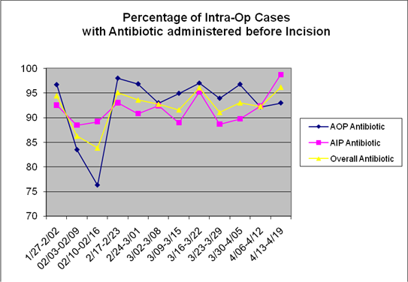
Use objective data
2006 –AIMS
2009 – Started a weekly report
  Generic
  By Location
  SCIP activities
  Admin always asking for 100%
  Anonymous
  Educated “poor” performers privately
  When 1-2 items worked OK
WEEKLY EMAIL
70
Notes:
USE OBJECTIVE DATA THEN FIX IT
CONCEPT WAS IF WE KNOW WE WILL SPONTANEOUSLY DO THE RIGHT THING

Slide 8
Issues with Generic
Faculty were accountable and not accountable
Non-physician caregivers had variable buy in and no responsibility except a conversation with ???
Residents were too busy and came from so many locations, they just forgot or could not remember how to do some of the obscure charting.
Notes:
GOAL WAS CONSISTENT 95%--ORGANIZ WANTED 100%
GRAPH ANYTIME IN NEXT 2 YRS OF MAYBE 8 YRS.
FAILED MOTIVATE AND SYSTEMS FIXES

Slide 9
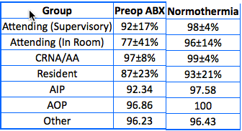
2010--Provider and Location Report
LIST of measures for this year
Preop antibiotics, Normothermia
Notes:
CHANGE—BY PROVIDER GROUP
MAYBE IMPROVED charting
BUT HOW GOOD WAS GOOD ENOUGH.
NORMOTHERMAIA HINT FOR FUTURE—STANDARDOF PRACTICE
RECORDED AUTOMATICALLY.
FAILURE LIKELY ACCURATE—STILL NOT 100%
DID IT MATTER?
Variation due to crazy values or hyperthermia surgeons

Slide 10

2011--Issue was what we measured
The Measures were not ours.
Measures seemed to not matter
More pressure to use administrative measures
  In room time, turnover time,
  “fast” 3 seconds late too bad
Notes:
OFFICIAL MEASURE OF ANESTHESIA VERY LIMITED
ATB NOT EVEN OURS REALLY
WHAT IF WE MEASURED NOT WHAT WAS APPROVED BY AN A QUALITY ORGANIZATIONS)
WHAT IF WE CHOOSE THINGS THAT COULD MATTER IN OUR PRACTICE
SO WE DID– (OUR BEGINNINGS OF (QCDR – ASPIRE)
WHAT IF WE COULD AGREE SOME THINGS WE SHOULD DO ROUTINELY MATTERED

Slide 11

Assumption: Our measures
Our commitment
INSIDE--Social pressure to perform within a standard was being diluted by growth
  Needed to be explicit
OUTSIDE—Increased pressure for more measures—
  Hospital requests all financial (time related),
  Departmental wanted to improve the bottom line with clinical care
Notes:
Our own standard from across the ENTIRE COMMUNITY OF PRACTICE.
WE WOULD HAVE STANDARDS OR EXPECTATIONS IN OUR COMMUNITY
WHILE THE REQUIREMENT FOR CHANGE FROM CMS
INCLUDED ADMINSTRATIVE IDEAS THEY WERE NOT SOLELY TIME OR COST DIRECTED
WE NEEDED TO IMPORVE OUR CARE

Slide 12
New Measures-1st Rule
CURRENT Measurable ACTIVITY
Example
  Measure: Lung protective ventilation practices expected
    Automatic tidal volume, PEEP and RR recorded
  Action:
    Values must be ADJUSTED based on patient characteristics
Notes:
WANTED TO CHANGE CARE BUT NOT “NEW” CHARTING ELEMENTS TO REMEBER

Slide 13
New Measures--2nd Rule
YES!!!!!
There must be some evidence about best practices
Meta analysis, several review articles, best practice guidelines which rates the evidence
NO!!!!!
One of my partners like to do it that way
When I was a resident that’s what they taught me
TRADITION, TRADITION
Notes:
Break with tradition but
CAN’T BE WORSE THAN DOING THINGS THAT WERE comfortable but DISCREDITED.

Slide 14

Process
ALL members submitted suggestions
Applied 85% rule-- 85% group could participate 50% of the time.
Measures could be administrative but with agreed clinical consequences.
EXPECTED outcome goal or consequence
Anticipated as actions became habits would change actions (eg, reversal of nondepolarizing muscle relaxants)
Consensus won
Notes:
QUALITY MEASURES WERE GATHERED FROM SCIP FOR OTHER SPECIALTIES,
IMPORTANT TO HSURGEONS, PATIENTS HOSPITAL—WE DID A LARGE PORTION OF CARE
CENTRAL LINE ACCESS.

Slide 15
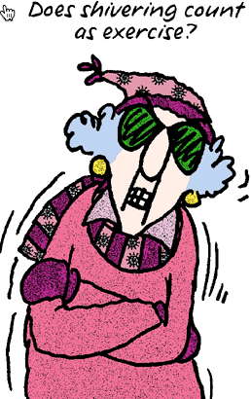
Our List—1.0
Antibiotics—stayed by popular (hospital?) demand
Temperature—Good evidence on SSI and we would no longer freeze in the OR.
Ultrasound for Central Line Placement—good evidence for line infection and sepsis.
  Plus the hospital would have to provide more devices
Reversal of Nondepolarizing Muscle Relaxants—increased frequency of re-intubations in PACU and floor
Notes:
VERSION 2.0
INCLUDED PONV AND QUALITY OUTCOMES CHARTING FOR EVERY CASE

Slide 16
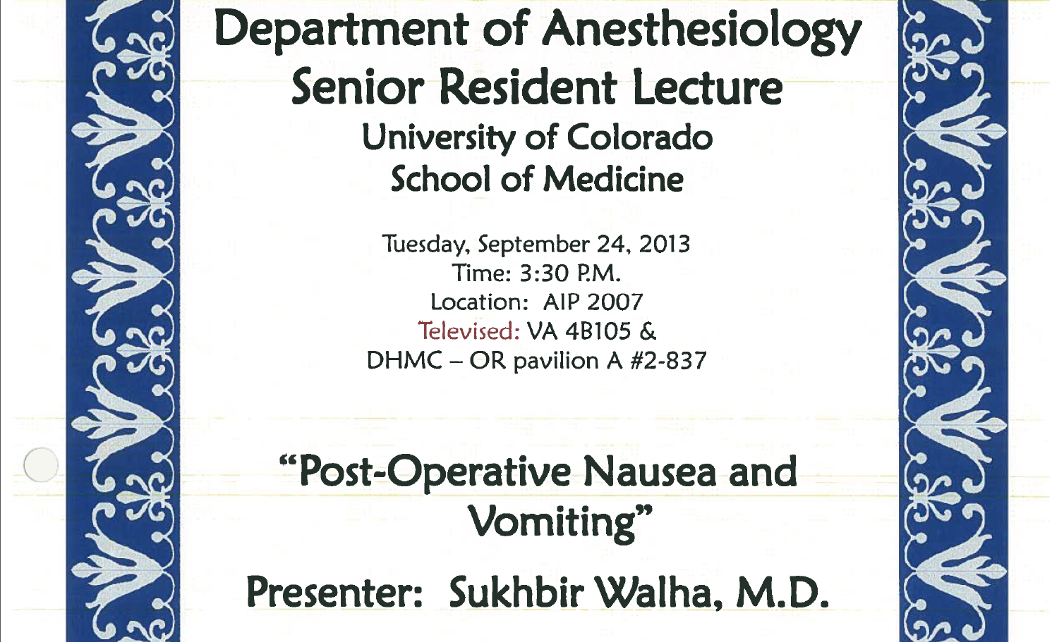
Start with Education
Notes:
Before started

Slide 17

Rubber hits the Road
Will we comply with our own measures????
Well sort of
Now had a Director of Perioperative Services saying we would have 100% compliance on clinical measures and 80% compliance on time measures (another story).
Notes:
Discussions about the why not perfect were SOCIAL
I didn’t agree,
not my measure,
I just forgot,
there are too many things to do……..
STRESS--In the mean time we had gone from a well developed AIMS to a new EMR—I mean new #2 in the country to try to make it an anesthesia product.
Things were a great deal harder.

Slide 18
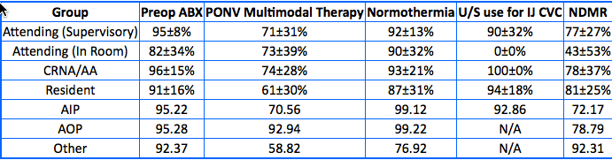
AT 8 Months
Still well, not exactly
Added a few more measures -- v. 2.0
  PONV—hospital metric we agreed with
  Epic Quality reporting available so now but not yet mandatory.
Notes:
Consistent on originals and ultrasound __physician only measure
To quire variable for social items.
Irony—don’t use reverse causes PONV but I don’t want to give drugs for PONV
Is educational battle with just about every new hire including faculty.

Slide 19
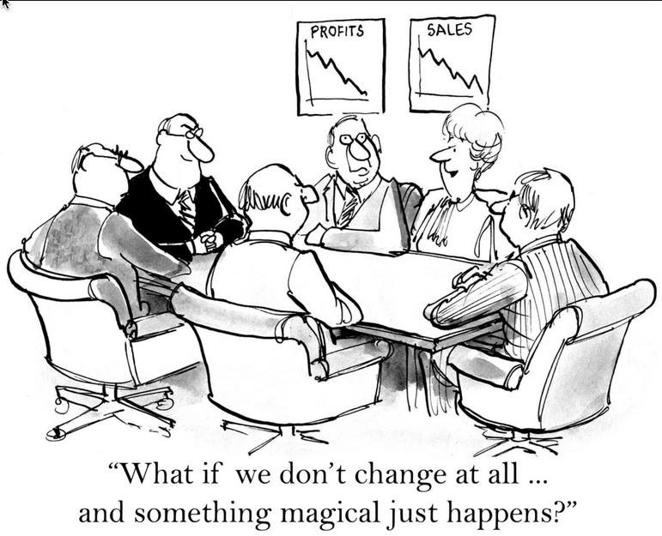
Impact of CHANGE
2010—New EMR
2014 Quadrupled faculty and mid-level provider numbers
Doubled anesthetizing locations
UCH grew 20%-30% each year since 2011
Hey, we’re a “System” with 2 large Independent Hospital Organization with all private practice physicians
Notes:
BELOW EXPECTATIONS FOR OUR OUR GOALS
–ADMIN BUT OUR MEASURED OUTCOMES WERE GREAT (OR SO THEY SAID)
“WE MEANING HOSPITAL WERE LOW PERFORMERS ACCORDING TO OUR QUALITY PEOPLE—
INTERESTING NO ONE ELSE IMPROVING OUT STUFF BUT REPORTING WAS NOT 100%.

Slide 20

November 2011 --- Radical Change
Public individually identified reporting on compliance begins
  Used public accountability on the web for everything about us soooooo why not.
  Weekly public list (email) with names and values
    Performance level established for hospital credentialing
    Hospital quality monitoring is public--(really public) all measures were departmentally reported.
A fire storm of ANGST
Notes:
MAYBE THE PROBLEM WAS DID DIDIN’T KNOW WHAT WE DIDN’T KNOW –POOR CHART? POOR ACTION??
WHAT MATTERED IS WE CARED AND NOT THE CHARTING % BUT FINALLY JUST GAVE UP.
Report was all memberrs
TRUE BELIEVERS THAT POSTING GRADES MATTERED
LEAPE WOULD SAY 100% IS ARTIFACT AND TOO ERR IS HUMAN PHILOSOPHY
HUMANS ARE CARELESS BUT SYSTEMS FAILL
click

Slide 21
More Success with new format???
  Theory—people noticed low performance and helped each other technically so it became “oh, you just didn’t know how to chart this.”
  Activate competitive spirit
  ????????? (humiliation works)
Notes:
----- Meeting Notes (3/10/15 17:18) -----
The forever optimists
The sports group
18th centurry school marm
WE REALLY DIDN'T HAVE A WAY TO CONVINCE PEOPLE
IT WAS WORKING AND WORTHWHILE

Slide 22

Criticism
Don’t know the “rules”
I did it and you made a mistake
I’ll just go and change it
Doesn’t matter anyway.
I’m Mad!!!
Notes:
I’m Mad—we had to confront we were not a perfect as we thought
Everyone believed they had met the measures
So was this a EUREKA moment– fist fixed justified criticiisms

Slide 23
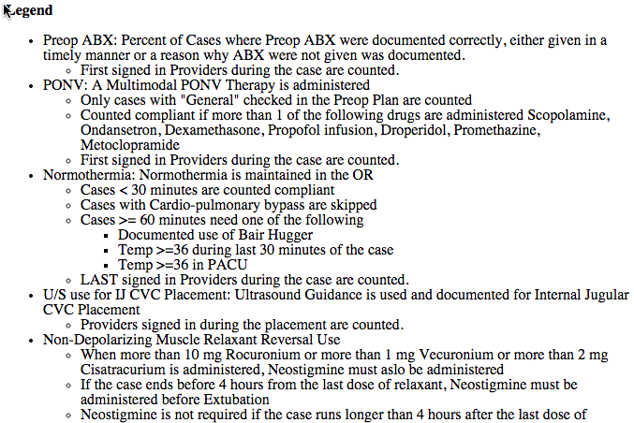
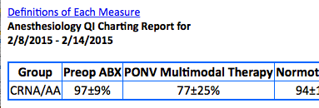
Criteria for compliance
Used KISS principles
2-3 months of “learning” before new criteria “counted”
Time included education at grand rounds or in Resident Senior Lecture
Today you can “hover” over each measure and get the criteria

Slide 24
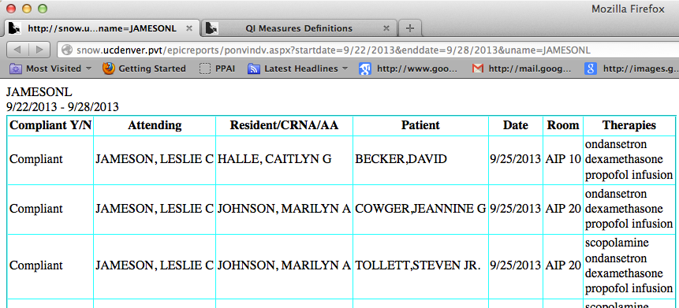
I did it and you made a mistake
Data integrity:
Learning where or who or if there was an error with a list of noncompliant/compliant patients

Slide 25
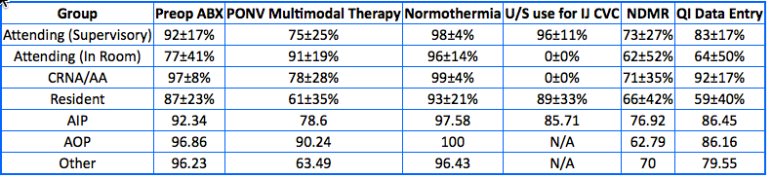
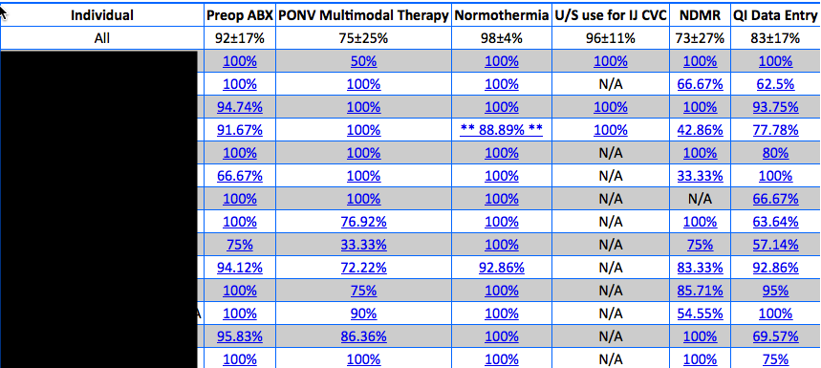
What it looks like at 3 months
Notes:
Hoorah it worked
Hmm, not really

Slide 26
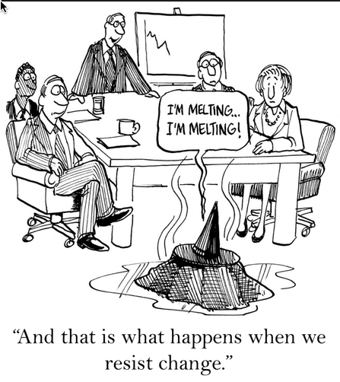
Increasing the Ante one more time!!!
Off to the Hospital credentialing.
Notes:
Perfect or not your credentialing will require it.

Slide 27
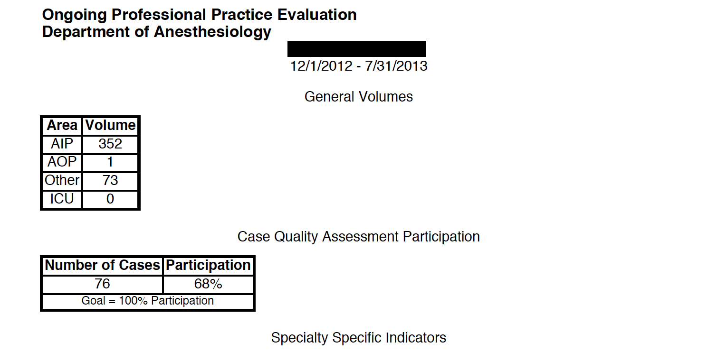
Credentialing Form
Filed automatically from our IT every 4-6 months
Available to public as in the internet

Slide 28
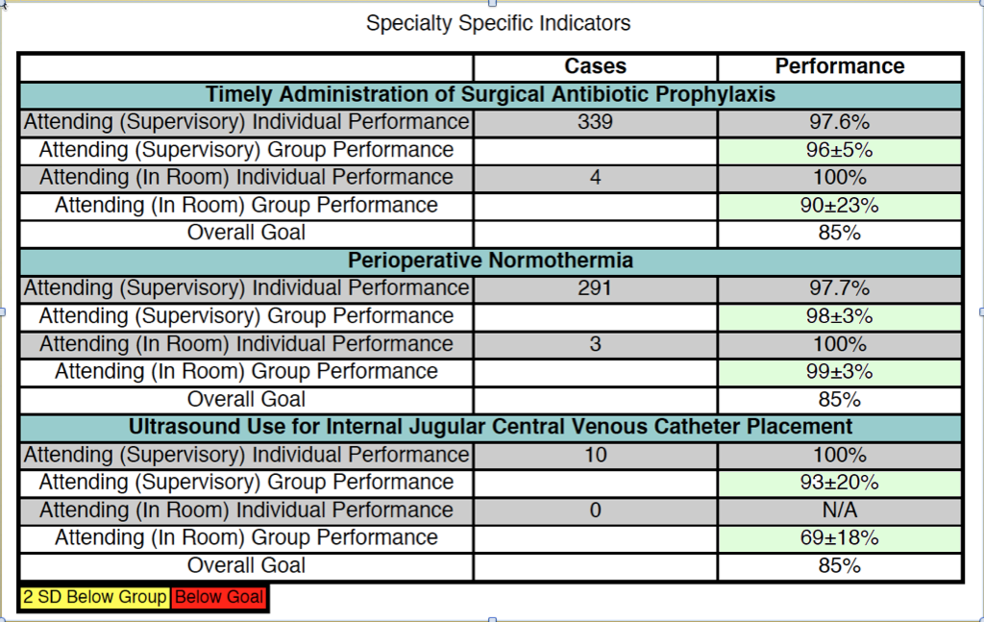
Notes:
----- Meeting Notes (3/10/15 18:56) -----
This is more than just departmenatal this goes to the Web and is encorporated into the Dr. Jameson web sites around co

Slide 29
Added stress but not better performance

Slide 30
Final Act—Be CMS and Pay people
AA/CRNA-- Monthly Incentive May 2014
  Payout is based on total $$ available for month/# of CRNA/AA FTE.
  Your payment based FTE
Criteria
ELIGIBLE--100% Antibiotic charting
50% PAYOUT if
  80% of AIP Goal for On-Time AND 80% of AOP Goal for On-Time
Full Payout if
  90% of AIP Goal for On-Time AND 90% of Goal for On-Time
  The 65% & 70% are UCH Goals for On-Time Starts

Slide 31
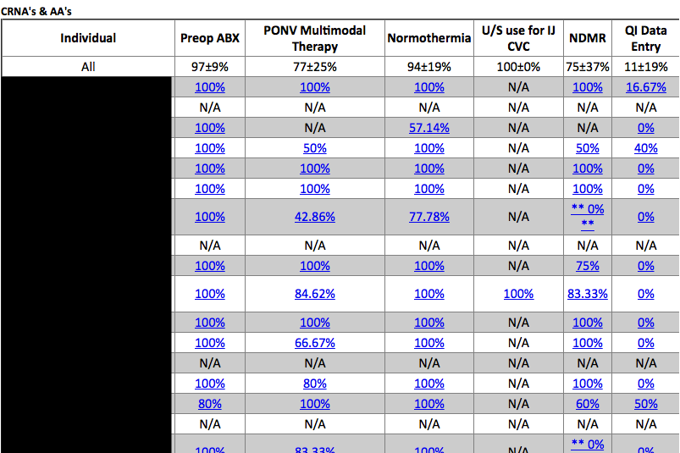
Effect—better charting but different care?
THIS IS ABOUT AN IMAGE NOT AN OUTCOME
Notes:
FINALLY—WE ALL GOT IT
THIS IS AN IMAGE NOT AN OUTCOME
(IT IS NICE THAT MOST OF IT WORKS BUT PROBABLY BY MAKING US AWARE. AND COLLABORATING
Had people routinely going back at end of week to chart.
THIS WAS THE TRUE EURECKA MOMENT

Slide 32
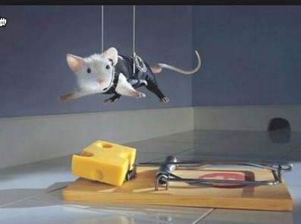
The TRAP
Notes:
Big trap– we were chasing numbers
just like CMS and the Q alphabet soup and the web sites.
I
THE REPORT DID NOTHING
AWARENESS DID EVERYTHING BUT PUBLIC IS OBESSED WITH IMAGE.
WAS THE REPORT OT THE ACTIVITY (IMPERCT) THAT MADE THINGS CHANGE
REPORT WAS NOT DID WE HAVE ANY UNCESSARY INTUBATION BUT WHAT WAS YOUR % COMPLIANCE THIS WEEK

Slide 33
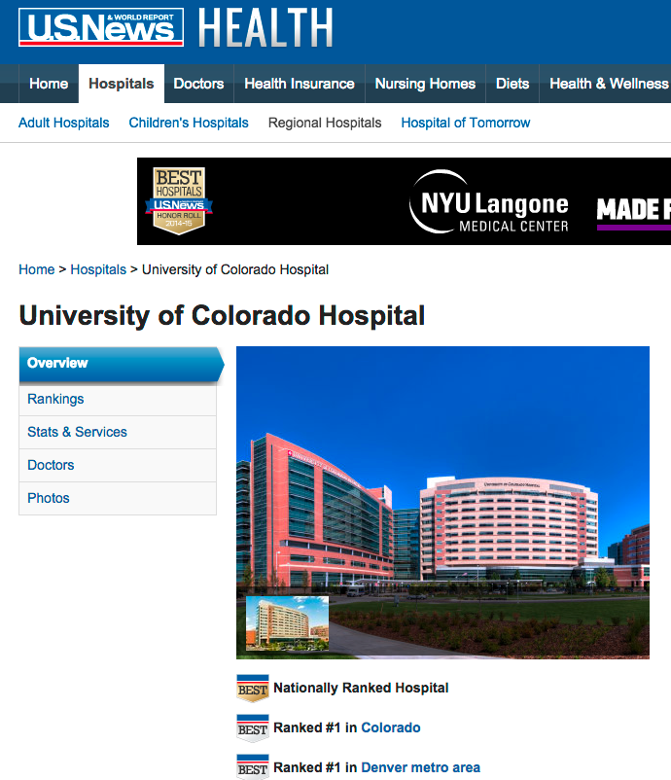
Why does it matter?
MONEY
FAME
MONEY
PRESTIGE
MONEY
MORE FAME
MONEY
LOWER BILLS
LOWER COSTS
FAME
Notes:
THE NUMBERS DO MATTER
SEEMS SHALLOW BUT NECESSARY
WE MIGHT JUST BE REALLY HELPING PEOPLE

Slide 34
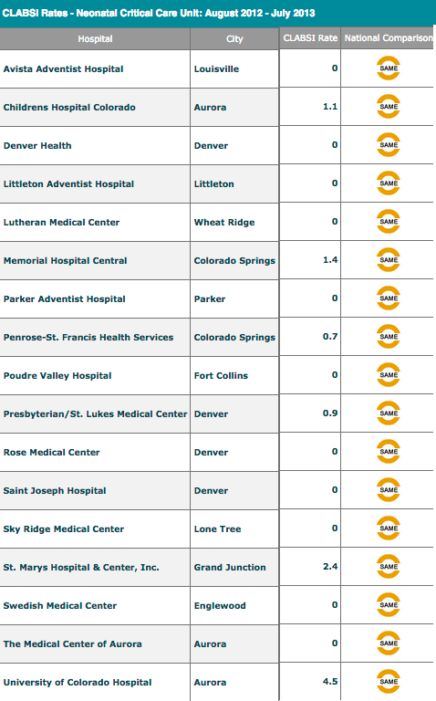
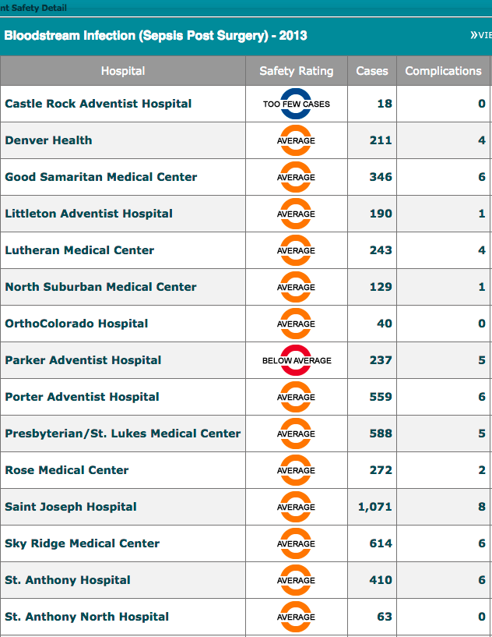
CAN WE TELL IF THIS MATTERS?
NOPE—NOT YET
Notes:
THESE ARE REAL EVENTS SINCE THEY ARE LAB MEASURED
YET IN 2013 (REPORTED IN 2014 THEY WERE “THE SAME AND AVERAGE.
MEASURED IN A LAB WITH Y OR N JUST LIKE OURS BUT NOTHING CHANGED

Slide 35
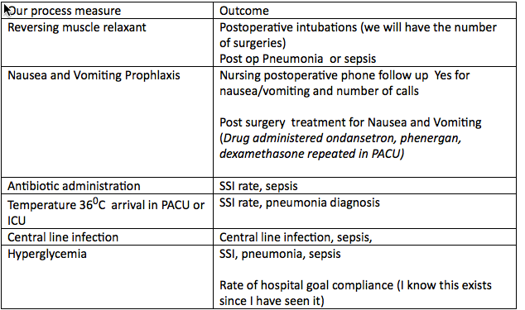
HOW ABOUT CLOSER TO HOME?
THE QUEST
Did our efforts work?
NOPE—No one in the hospital follows this but it is recorded on every patient (since 2010).
We can know what works
It matters to us
Notes:
Problem with this was it was an after the fact look.
Largely because until 37 days ago we could not get info easily out of our EMR.
You will note we have hyperglycemia here.
BEGINNING OF OUR NEXT APPROACH--That was our next project and we are doing it inside ASPIRE

Slide 36
Did anyone in the hospital keep track or know what we were doing?
Was there a global corrdinating body that got everyone together?
NOPE—NOT YET

Slide 37
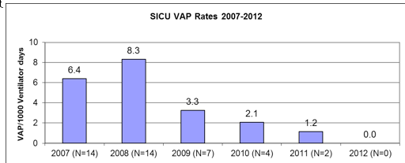
Ventilator Associated Pneumonia
Antibiotic measure
Reversal NDMR
Notes:
RED CIRCLE —SCIP FOR ANTIBIOTIC DISCUSS AND SORT OF IMPLEMENTED
BLUE –WE WERE GENERALLY REPORTING (BY CARE AREA)
GREEN REPORTING BY AREA AND ROLE
YELLOW ADDED NEW ITEMS LIKE NDMR
2012

Slide 38
‘07 ’08 ‘09-‘10 ‘11
Notes:
GREEN ATBI -1 YR
BLUE AREA REPORT
ORANGE 2009 TO 10+ PRACTICE GROUP
ADD ITEMS
YELLOW INDIVIDUAL

Slide 39
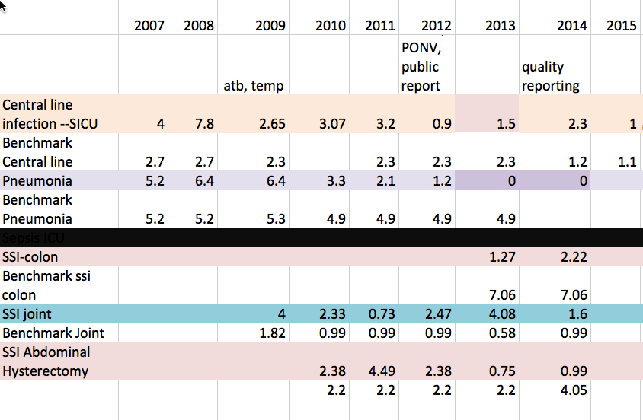
What else?

Slide 40
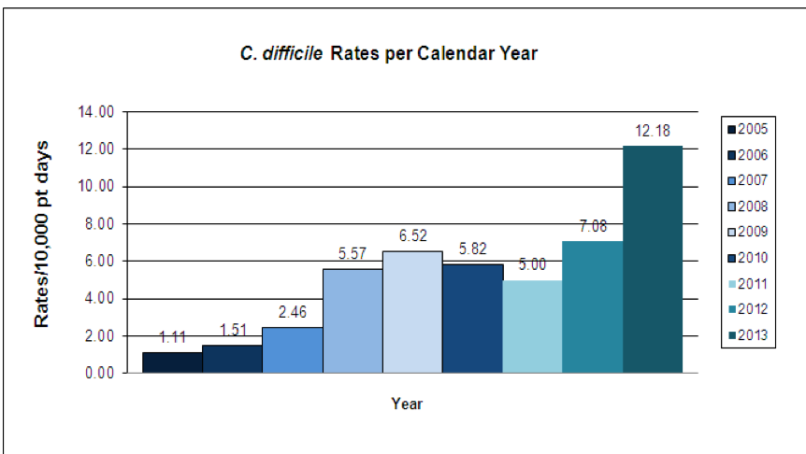
Sometimes things just get worse

Slide 41
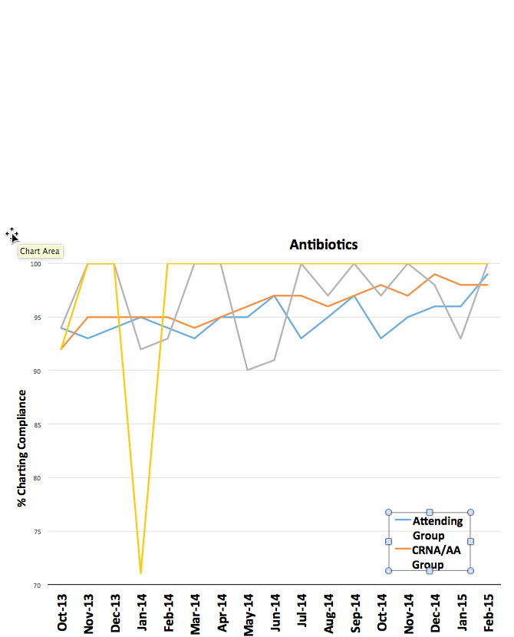
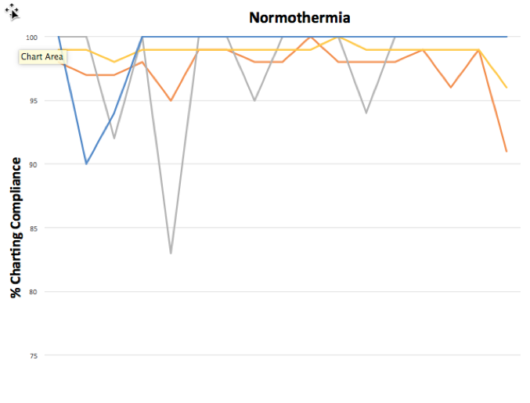
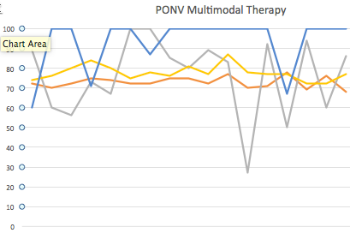
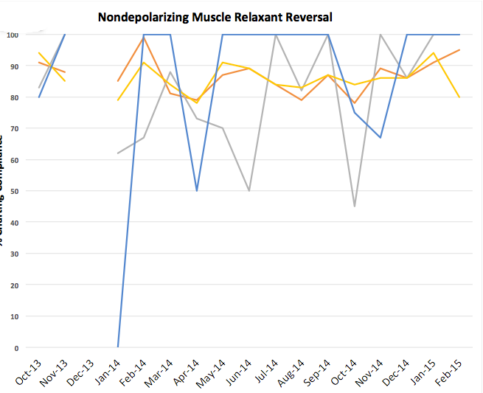
Random numbers?
Notes:
This is a Picasso—Not ment to be read but it is meant to leave the impression that over 17 months there is no predicting Charting performance.

Slide 42
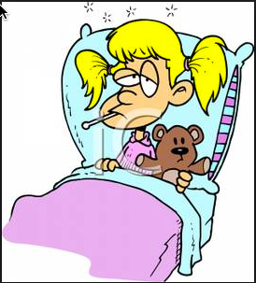
Dr. Leape again--
The best way to get change
  is to make it personal—
    your patient,
    your friend,
    your family

Slide 43
Central line—No infections from OR for 18 months
NDMR-REVERSAL
  Re--intubations in PACU 3/week to 6/year
  Pneumonia rate down 50%
PONV
  Subjective—much lower N & V
    Preemptive treatment much more likely (eg. Propofol infusion)
Ventilation changes
  No real measure but rate of unexpected admit to ICU in OSA patients lower than non OSA patients.
Notes:
Ventilation was another project but it reflects the concept that being AWARE changes practice. And collaboration—nursing-phone call, surgeons reminding, pacu, respiratory, us –following up

Slide 44
Conclusion from all this
The final step toward success
Pragmatic Collaboration
We need to recognize the trap (fallacy) that recording numbers is fraught with human error
Actions
Doing deeds is a celebration of success and uses numbers as the reminder
Nothing is 100% or 0%--Surgery causes injury. Actions that contribute to reducing injury matters
Reality – Consolidate your gains

Slide 45
Finally Finally Finally
Plan your outcome goal first!
and measure it yourself
Maintain enthusiasm by seeing success
in your patients

Slide 46
Recommended Reading
JAMA Volume 313(5) 2015
Hospital Readmissions Following Surgery Turning Complications Into “Treasures” Lucian L. Leape,MD p 467
Underlying Reasons Associated With Hospital Readmission Following Surgery in the United States RP Merkow. ….. KY Bilimoria p. 483
National Hospital Ratings Systems Share Few Common Scores And May Generate Confusion Instead Of Clarity JM Austin…..PJ Pronovost http://content.healthaffairs.org/content/34/3/423.full.html
Notes:
FIXING THE PUNITIVE ACTIONS
SURGERY IS AN INJURY SO CAN ONLY MITIDGATE CONSEQUENCES OF THAT
PREOP OPTIMIZATION, INTRAOP MANAGEMENT, POST OP CARE
MY SUMMARY IS THE EMPEROR HAS NO CLOTHES

Slide 47

Pick an outcome then an agent of change
DSC_1391 copy.MOV

Slide 48

Notes:
Personallh I think it is going to snow.

Slide 50
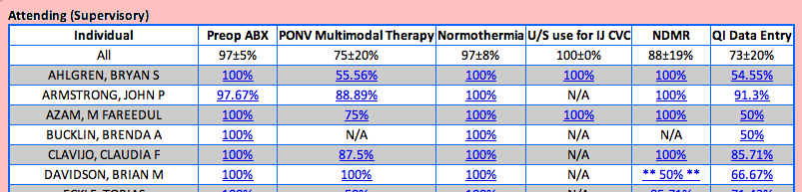
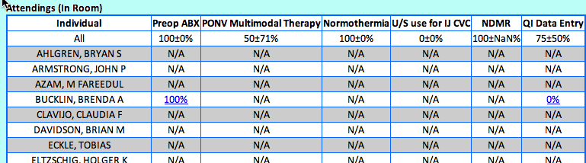
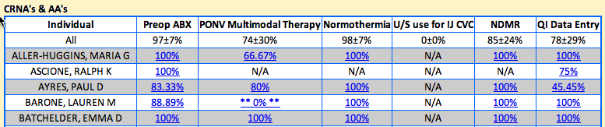
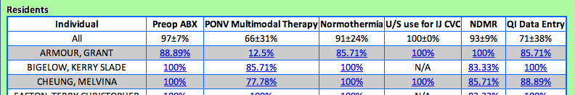
Weekly report from IT 2015

Slide 51
What it looks like at 3 weeks
Notes:
Looks shocking like the other tables I have displayed

